Slide 1
INTER-AMERICAN DRUG ABUSE
CONTROL COMMISSION
C I C A D
Secretariat for Multidimensional Security
SEVENTIETH REGULAR CICAD SESSION
November 16th-19th, 2021
Virtual Session
OEA/Ser.L/ XIV.2.70
CICAD/doc.2616/21
November 18, 2021
Textual
VIVIANE YARGEAU
SESSION 6, PANEL 6
WASTEWATER SURVEILLANCE TO MONITOR CONSUMPTION OF ILLICIT DRUGS

Slide 2
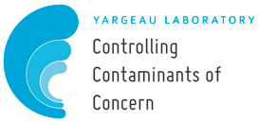
Wastewater surveillance to monitor consumption of illicit drugs
PANEL 6: Wastewater studies as a tool to estimate drug use
November 18, 2021
Viviane Yargeau
Professor & Department Chair
Department Of Chemical Engineering
McGill University
Montreal, Quebec, Canada

Slide 3
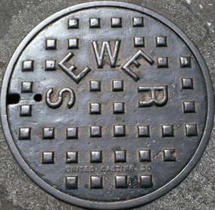
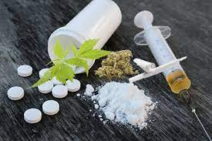
Wastewater-based epidemiology (WBE)
What we have learned
Some interesting results

Slide 4
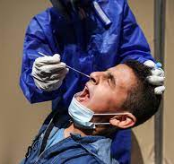
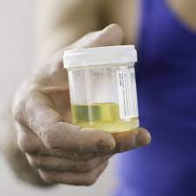
Conventional approaches to obtain information about a population
Mechanisms to obtain information about a population
Survey (online, over the phone, questionnaires, etc)
Sales reports
Collecting human specimens
Prescription drug trend reports
Statistics on drug seizures

Slide 5
Wastewater-based epidemiology approach
Population served by a wastewater treatment plant
Doses per day per 1000 people
Dose (estimates)
Eg. 100 mg for MDMA (Ecstasy)
100 mg for intranasal cocaine
30 mg for oral amphetamines
Excretion rate
Eg. 65% for MDMA (Ecstasy)
45% cocaine excreted as benzoylecgonine
30% excretion of amphetamines
Volumetric flow rate of water treated
Analysis of the concentration of drugs
Zuccato, E., Chiabrando, Castiglioni, S., S., Bagnati, R., Fanelli, R. (2008)
Environment Health Perspective

Slide 6
Several drugs/metabolites can be monitored
Cocaine & its metabolites
Amphetamine-type stimulants
Opioids
Codeine
Cocaine
Benzoylecgonine
Amphetamine
Methamphetamine
MDA
MDMA
Ephedrine
Acetylcodeine
Dihydrocodeine
Ketamine
Morphine
Methadone
Heroin
Oxycodone
Tramadol
Fentanyl
Cannabis
Delta9-THC (THC)
Cannabidiol (CBD) Cannabinol (CBN) 11-hydroxy-THC (THCOH) 11-nor-9-carboxy-THC (THC-COOH)
+ New psychoactive substances, etc

Slide 7
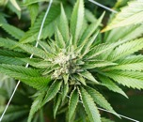
Work in Canada, Barbados, Mexico…
Read Zuccato et al.
Project in Mexico
Pan-Canadian pilot project
Project in Barbados
Methods developed and applied to
few municipalities in Quebec & Ontario
(in collaboration with C. Metcalfe)
Participated along with two municipalities in Quebec
We joined the Europe⁺ SCORE project
V. Yargeau, Chemical Engineering, McGill

Slide 8
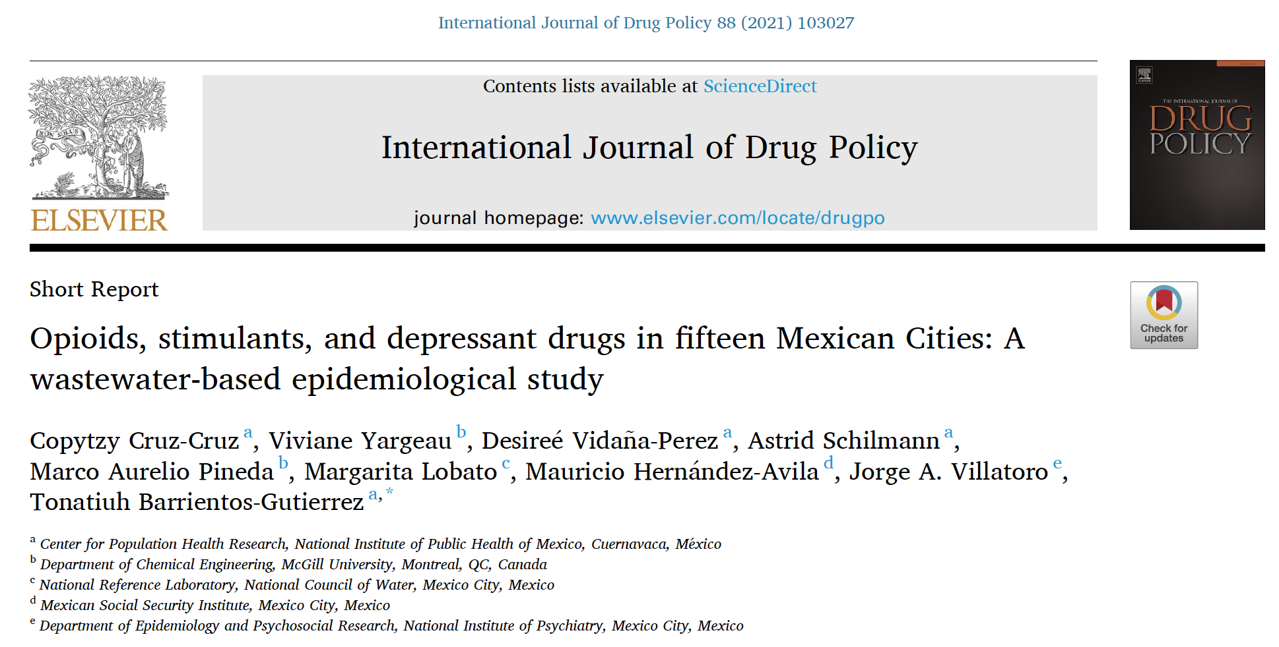
¹ Department of Biological and Chemical Sciences, University of the West Indies, Cave Hill Campus, Bridgetown, West Indies, Barbados
² Water Quality Centre, Trent University, Peterborough, ON, Canada
³ Department of Chemical Engineering, Montreal, QC, Canada

Slide 9
Sensitive enough to detect daily variations
2010-2011
YARGEAU, V., TAYLOR, B., LI, H., RODAYAN, A., METCALFE, C. (2014)
Science of the Total Environment

Slide 10
Estimates comparable to survey results
UNODC, 2008

Slide 11
Estimates comparable to survey results
UNODC, 2008
Our study

Slide 12
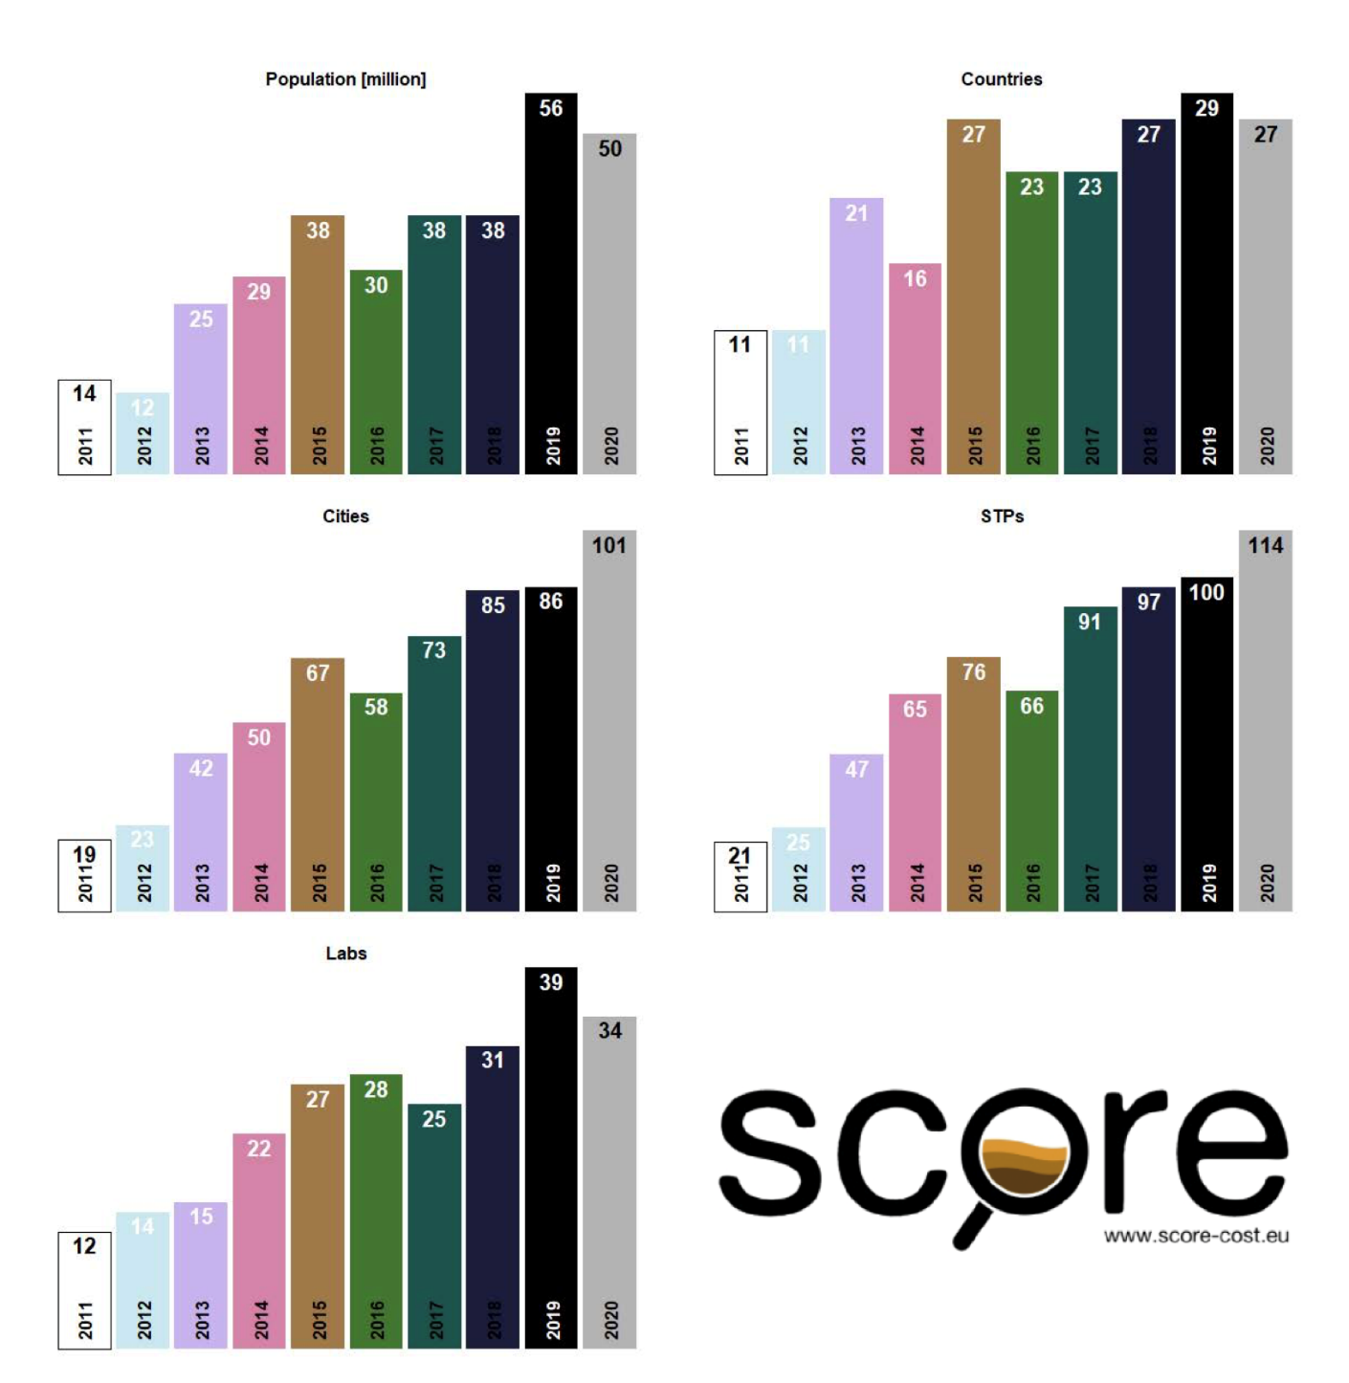
Used in ~30 countries and > 100 cities
Population (million)
# of countries
# of cities
# of treatment plants
# of labs

Slide 13
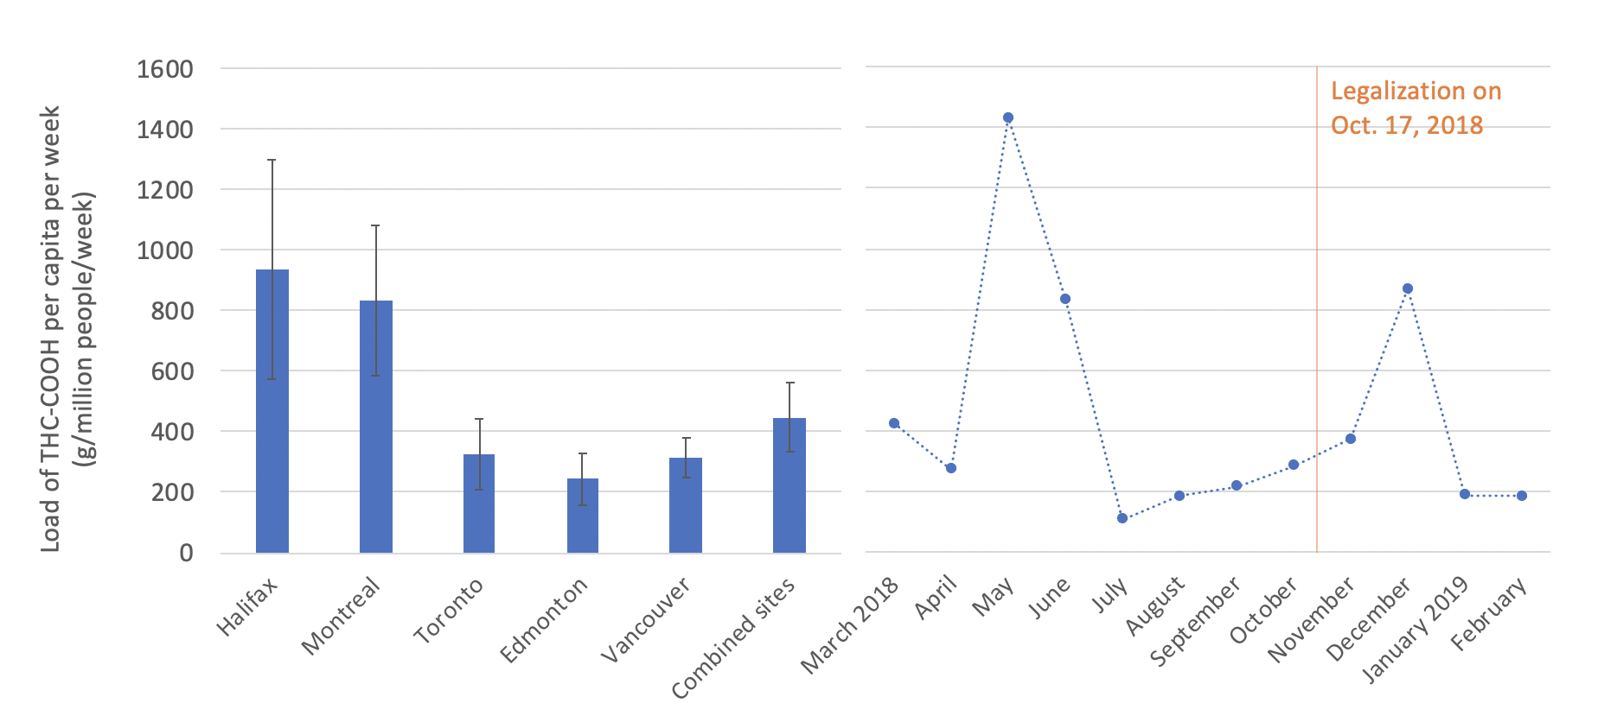
Can be applied to large population… 8,4M
Book chapter “The estimation of cannabis consumption through wastewater analysis” in
Wastewater-Based Epidemiology: Estimation of Community Consumption of Drugs and Diets
ACS Symposium Series #1319

Slide 14
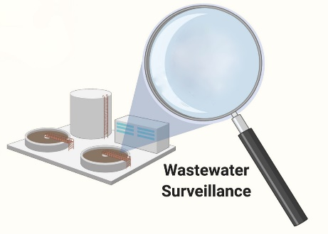
What we have learned over the years about WBE
Ability to monitor changes over time, even short periods of time
Possibility of finer geographical resolution compared to conventional methods
Detection of trends
Fast, relative cheap, no-invasive approach
Can be scaled from institution to city level or more
Avoids under-reporting and allows monitoring of emerging drugs
A new source of data
A new data source
Allows monitoring over time in quasi-real time
Can be used for other biomarkers (disease, population heath, etc.
An early warning system
Ethical risks for WBE have been identified
Strategies to mitigate those risks have been proposed
Ethics

